Slide 1
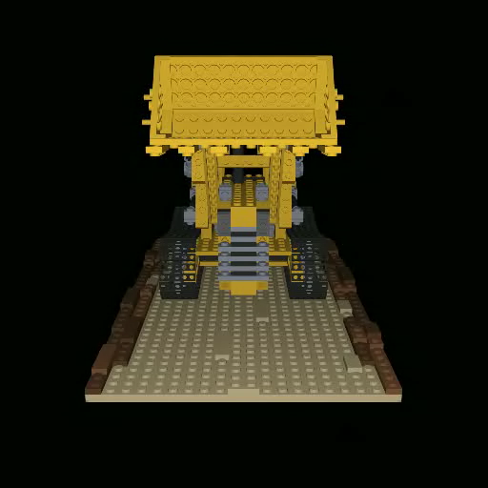
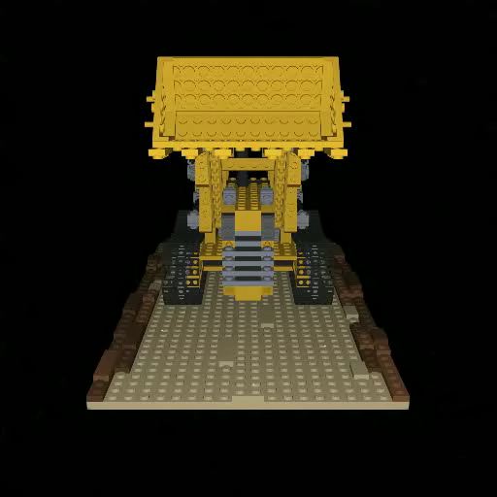
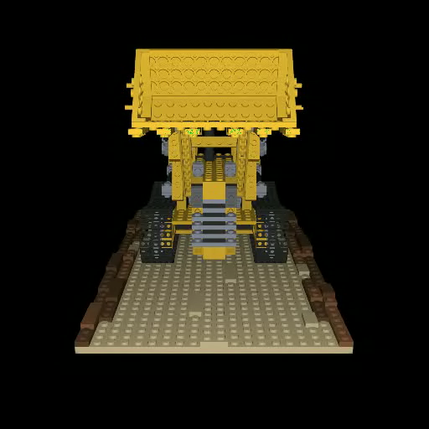
Trained on five views
DS-NeRF
[Deng ‘22]
Urban Radiance Fields
[Rematas ‘22]
Transient NeRF

